Slide 1
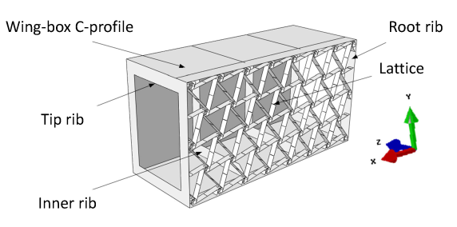
Bending-twist Shape Adaptation By Compliant Chiral Spar Design
Alejandro Valverde López
Approach to Problem
Supervisor – Dr. Simon Prince (Cranfield)
Advisor – Falk Runkel (ETH)
In the scope of this work, a full model of the whole wing-box with the compliant variable-stiffness spar is studied. Two models are developed, one numerical and another one analytical. The computational model is built in a fully parameterized version using Python scripting and allowing multiple design configuration variations (Fig. 3). The evolution of the buckling phenomena in the structure is characterized and the effect of the different design parameters on the structure pre-buckling and post-buckling response is assessed.
Introduction
Fig 5: Displacement (twist) - force curve for the baseline configuration
During certain flight conditions such as gust encountering, the aircraft may experience critical loads that threaten the structural integrity. To counteract this situation, a time-bounded modification of the lift distribution to achieve a reduction in the aerodynamic load is needed. The proposed method aims to control the bending-twist coupling of the wing-box affecting its torsional stiffness. The design of this wing-box incorporates a variable-stiffness adaptive spar implementation. This element is comprised of a lattice of chiral elements that undergo elastic instabilities on its ligaments under certain load, originating a sudden reduction of the shear modulus in the adaptive spar. The modification of the effective shear modulus in this element provokes the wing-box shear center shifting, a consequent modification of the torsional stiffness and, ultimately, a buckling-induced sectional twist in the wing-box (Fig. 1). The chiral structures incorporate curved ligaments that increase the bending stiffness and provide additional control the buckling phenomena (Fig. 2).
The aim is to provide a suitable computational environment to achieve in-depth understanding of the proposed working principle and assist the manufacture of a future demonstrator.
Fig 6: Colour contour plot showing deformation due to buckling
Fig 3: Computational model
Summary of Results
Results from the analytical model characterization anticipate that, once the buckling-induced reduction in shear modulus in the spar is activated, the reduction in flexural stiffness for the wing-box is negligible compared with the reduction in torsional stiffness (Fig. 4) . From the simulations carried out using Abaqus CAE, it can be seen how the twist induced is nonlinear as a consequence of the buckling phenomena occurrence in the ligaments of the chiral structure (Fig. 5). These instabilities become critical in those ligaments located at the root (Fig. 6).
Fig 7: Force that induces the structure to collapse as a function of the wing-box thickness
Conclusions
The proposed method has been shown to be capable of inducing global twist morphing of a wing-box exploiting local elastic instabilities. For the baseline configuration of the model, the twist morphing of the wing-box is obtained to be equal to -1.25 degrees for the nonlinear simulation while the predicted twist for the linear simulation is -0.19 degrees. Results show that considerable tailorability can be achieved through modifications of selected parameters. The parameter that shows to have a bigger influence in the onset and evolution of the elastic instabilities is the wing-box thickness (Fig. 7).
Fig 1: Working principle for the adaptive beam
Fig 2: Curved ligaments undergoing
elastic instabilities
Fig 4: Influence of the stiffness ratio on the wing-box twist and bending compliances

